Slide 1


Vacci-Chain: A Safe and Smarter Vaccine Storage and Monitoring System
By
Kamanashis Biswas
Vallipuram Muthukkumarasamy
Wee Lum Tan
K. Biswas
Vacci-Chain: A safe and smarter vaccine storage and monitoring system

Slide 2

Outline
Introduction
Limitations
What Is The Solution?
The Proposed System
Future Work
Conclusion
References
Introduction
Limitations
What is the Solution?
The Proposed System
Future Work
Conclusion
References
Vacci-Chain: A safe and smarter vaccine storage and monitoring system
K. Biswas
2

Slide 3
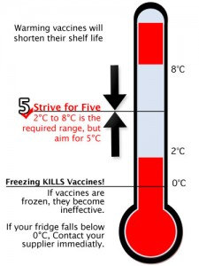
Vaccine Temperature
Introduction
Limitations
What Is The Solution?
The Proposed System
Future Work
Conclusion
References
Vaccine Temperature
Vaccine Storage
Data Collection and Monitoring
Vaccine: a delicate biological substance
Recommended temperature: 2 °C - 8 °C
Sensitive: freezing temperature or exposure to heat
Figure: Vaccine Storage Temperature*
* http://vaccinetemperature.com.au/
Vacci-Chain: A safe and smarter vaccine storage and monitoring system
K. Biswas
3

Slide 4
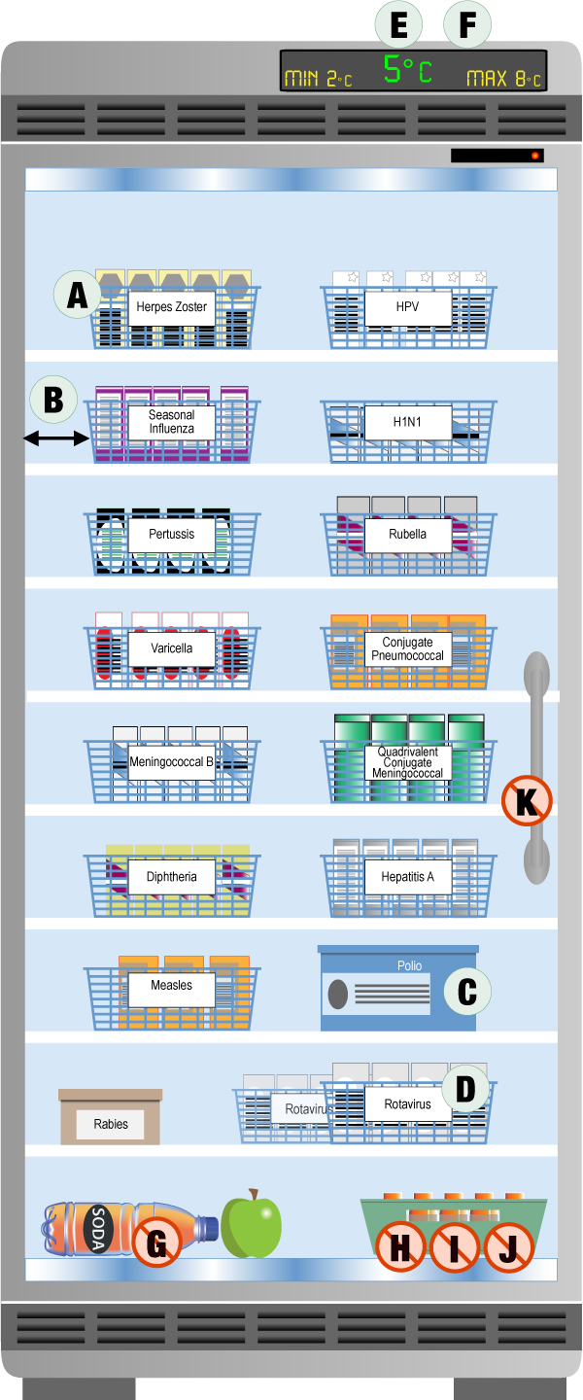
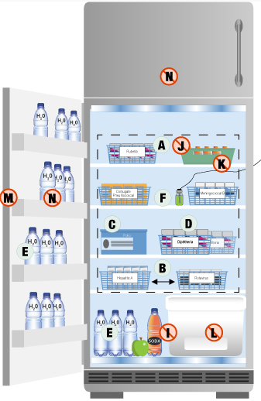
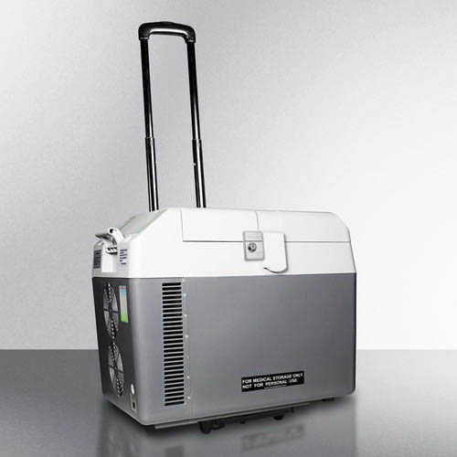
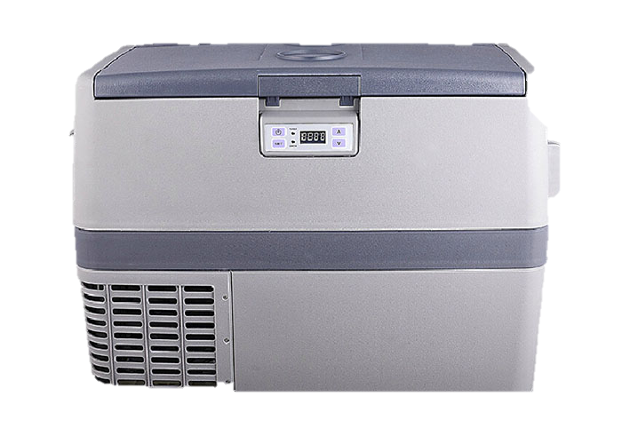
Vaccine Storage
Introduction
Limitations
What Is The Solution?
The Proposed System
Future Work
Conclusion
References
Vaccine Temperature
Vaccine Storage
Data Collection and Monitoring
Purpose-built vaccine refrigerator^{ⱡ}
Domestic refrigerator^{ⱡ}
Portable vaccine refrigerator†
ⱡ https://www.canada.ca/en/public-health/services/publications/healthy-living/national-vaccine-storage-handling-guidelines-immunization-providers-2015.html
† http://www.labfreez.com/MPR-series-portable-refrigerator
Vacci-Chain: A safe and smarter vaccine storage and monitoring system
K. Biswas
4

Slide 5
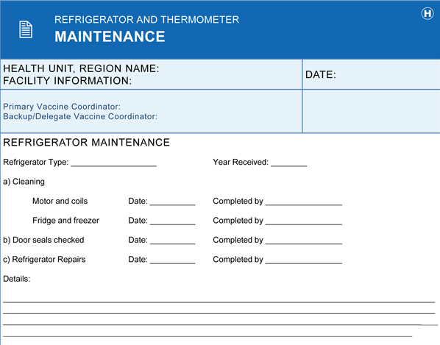
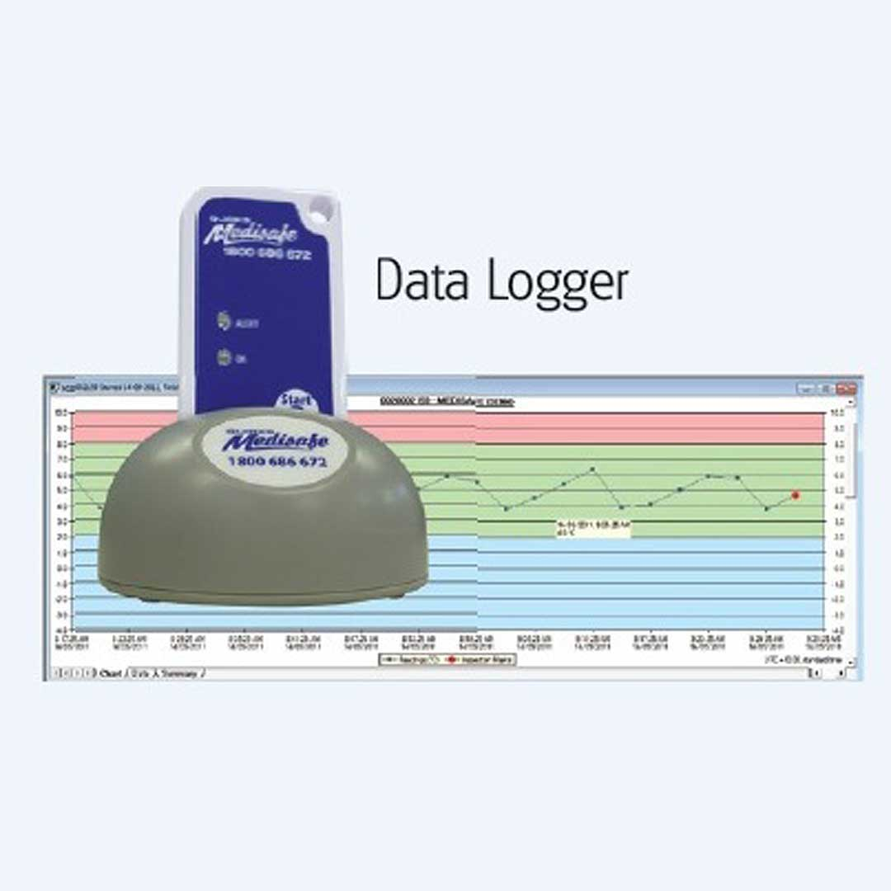
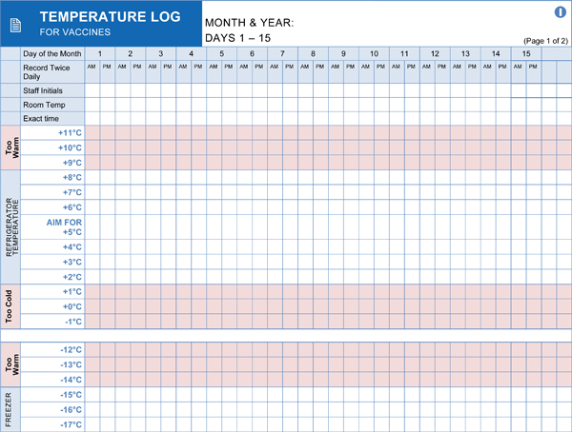
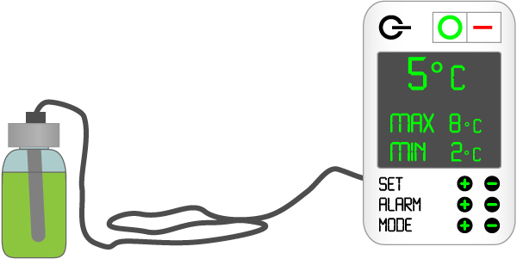
Data Collection and Monitoring
Introduction
Limitations
What Is The Solution?
The Proposed System
Future Work
Conclusion
References
Vaccine Temperature
Vaccine Storage
Data Collection and Monitoring
Data Logger†
Max/Min Thermometer^{ⱡ}
Manual Data Log ^{ⱡ}
† https://www.bar-fridges-australia.com.au/medicine-vaccine-glass-door-fridge-medisafe-fkg-371g2-381l.html
ⱡ https://www.canada.ca/en/public-health/services/publications/healthy-living/national-vaccine-storage-handling-guidelines-immunization-providers-2015.html
Vacci-Chain: A safe and smarter vaccine storage and monitoring system
K. Biswas
5

Slide 6
Hardware Issues
Introduction
Limitations
What Is The Solution?
The Proposed System
Future Work
Conclusion
References
Hardware Issues
Technical Issues
Purpose-built vaccine refrigerators
No in-built monitor and/or logger in some models
No battery backup facility in some models
Need to use a min/max thermometer
Domestic refrigerators
Temperature fluctuations
Non-uniform temperature
Must use a min/max thermometer & data logger
Vacci-Chain: A safe and smarter vaccine storage and monitoring system
K. Biswas
6

Slide 7
Introduction
Limitations
What Is The Solution?
The Proposed System
Future Work
Conclusion
References
Hardware Issues
Technical Issues
Technical Issues
Purpose-built vaccine refrigerators
Manually reset thermometer
Compromise/Manipulate data downloaded to a computer
Compromise in-built system
Domestic refrigerators
Very hard to deal with temperature changes
Use manual data log in most cases
NEED A SAFE, TRANSPARENT and TRACEABLE SOLUTION FOR VACCINE STORAGE AND MONITORING SYSTEM
Vacci-Chain: A safe and smarter vaccine storage and monitoring system
K. Biswas
7

Slide 8
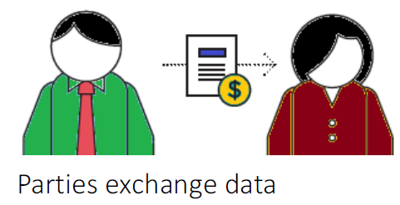
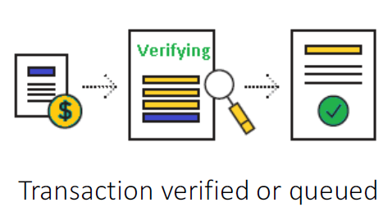
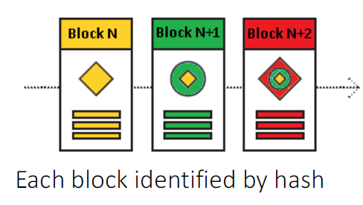
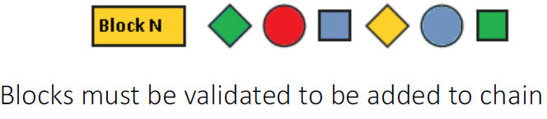
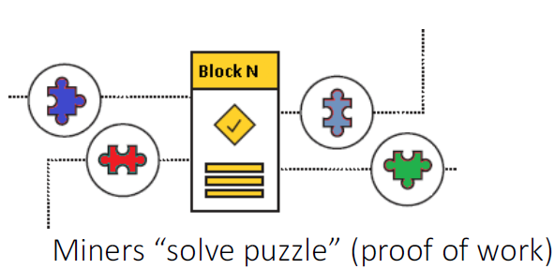
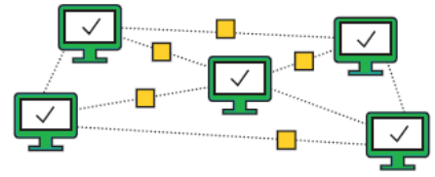
Introduction
Limitations
What Is The Solution?
The Proposed System
Future Work
Conclusion
References
Blockchain Technology
Why Blockchain?
Blockchain Technology
* https://www.rsaconference.com/writable/presentations/file_upload/fon4-t11_hacking_blockchain.pdf
Vacci-Chain: A safe and smarter vaccine storage and monitoring system
K. Biswas
8

Slide 9
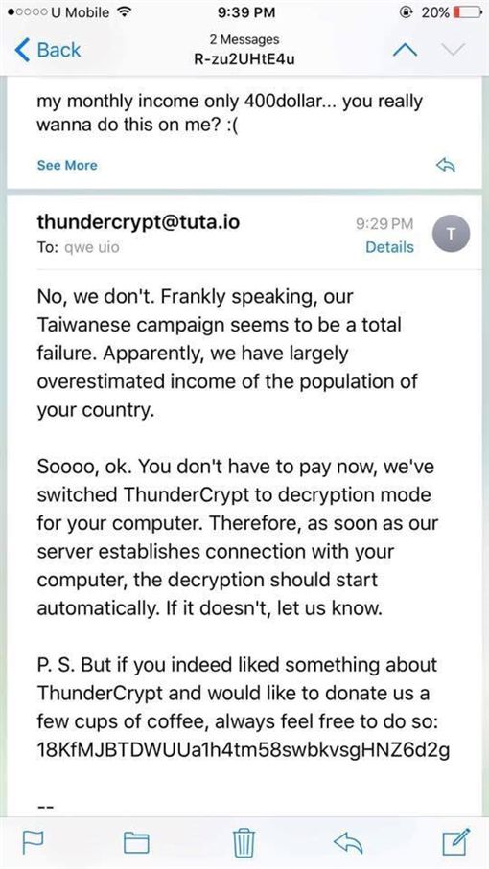
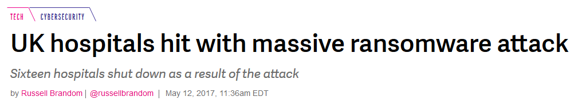
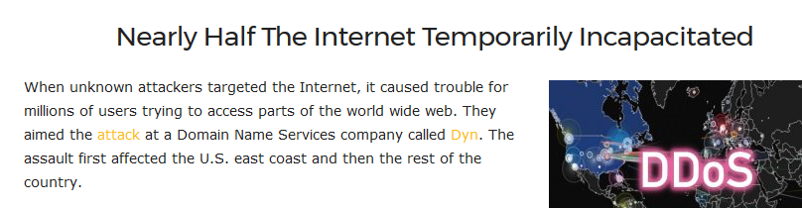
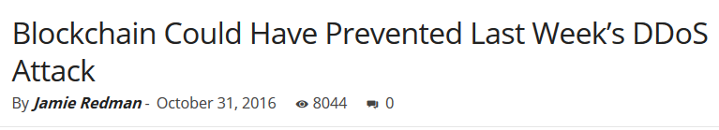
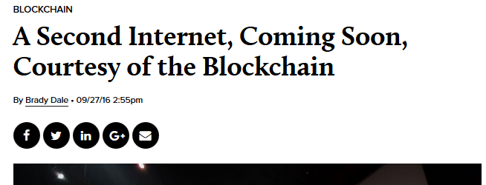
Introduction
Limitations
What Is The Solution?
The Proposed System
Future Work
Conclusion
References
Blockchain Technology
Why Blockchain?
Why Blockchain?
Vacci-Chain: A safe and smarter vaccine storage and monitoring system
K. Biswas
9

Slide 10
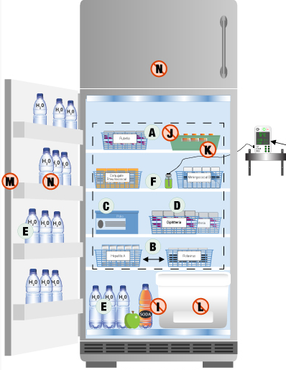

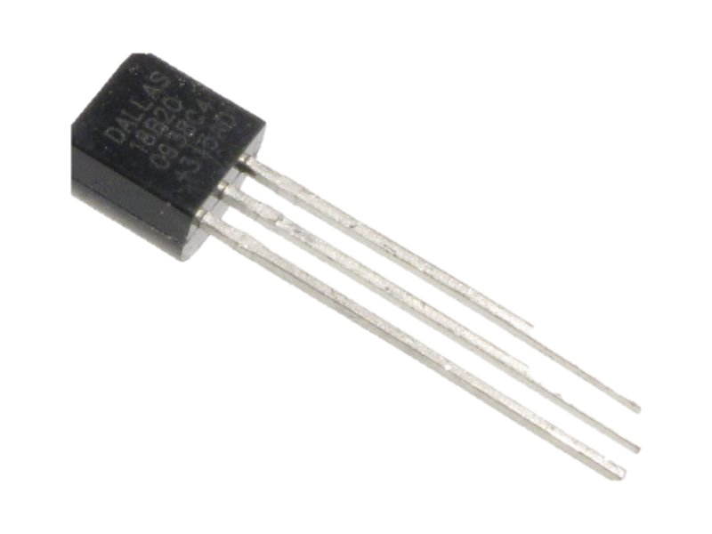
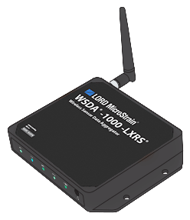
Introduction
Limitations
What Is The Solution?
The Proposed System
Future Work
Conclusion
References
System Architecture
Benefits
System Architecture
Distributed Ledger
Data Logger
Temperature Sensor
Aggregator
Miners
Domestic Refrigerator
Vacci-Chain: A safe and smarter vaccine storage and monitoring system
K. Biswas
10

Slide 11
Introduction
Limitations
What Is The Solution?
The Proposed System
Future Work
Conclusion
References
System Architecture
Benefits
Benefits
Transparency- every block in the chain is visible
Traceability- can trace the origin of vaccines, manufacturing & expiry date etc.
Accuracy- temperature data is stored accurately
Fault Tolerance- distributed ledger eliminates SPoF
Security- blockchain is immutable and irrefutable
Ease of Access- easily can check the history, availability etc.
Vacci-Chain: A safe and smarter vaccine storage and monitoring system
K. Biswas
11

Slide 12
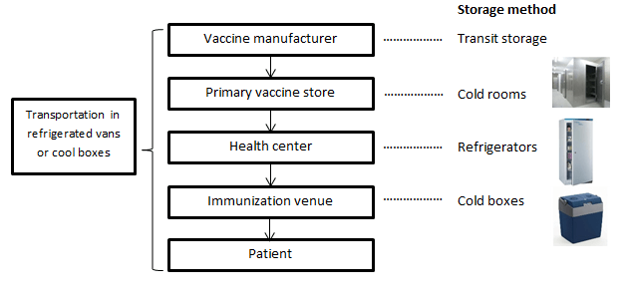
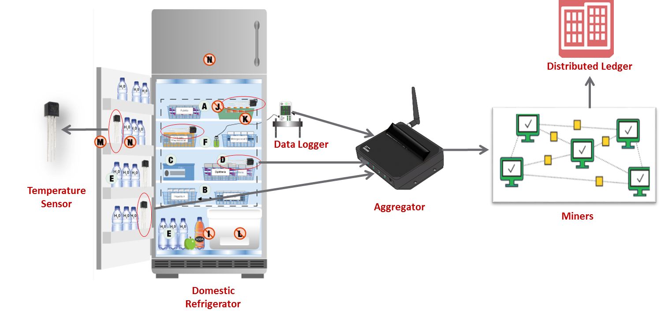
Introduction
Limitations
What Is The Solution?
The Proposed System
Future Work
Conclusion
References
Future Work
Vacci-Chain: A safe and smarter vaccine storage and monitoring system
K. Biswas
12

Slide 13
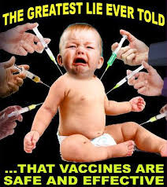
Conclusion
Introduction
Limitations
What Is The Solution?
The Proposed System
Future Work
Conclusion
References
Safe, secure and transparent system
Better traceability
Cost effective solution
Vacci-Chain: A safe and smarter vaccine storage and monitoring system
K. Biswas
13

Slide 14
References
Introduction
Limitations
What Is The Solution?
The Proposed System
Future Work
Conclusion
References
[1] Australian Government Department of Health and Ageing, National Vaccine Storage Standards, Strive for 5, 2nd Edition, 2013.
[2] R. Brandom, “UK hospitals hit with massive ransomware attack”, https://www.theverge.com/2017/5/12/15630354/nhs-hospitals-ransomware-hack-wannacry-bit coin, 2017.
[3] J. Redman, “Nearly half the Internet temporarily incapacitated”, https://news. bitcoin.com/blockchain-prevented-ddos-attack/, 2016.
[4] K. Karagiannis, “Hacking Blockchain”, RSA conference, San Francisco, https://www. rsaconference.com/writable/presentations/file_upload/fon4-t11_hacking_block chain.pdf, 2017.
Vacci-Chain: A safe and smarter vaccine storage and monitoring system
K. Biswas
14

Slide 15
Thanks for your attention !!!
Introduction
Limitations
What Is The Solution?
The Proposed System
Future Work
Conclusion
References
Vacci-Chain: A safe and smarter vaccine storage and monitoring system
K. Biswas
15

