Slide 1
Trust-based application of blockchain technology in Fintech: Australian Case Study
Raihana Ferdous, Vallipuram Muthukkumarasamy

Slide 2
Outline
Introduction
Proposed Solution
Conclusion and Future Directions

Slide 3
Introduction
Major challenges in Australian finance industries-
Introduction to Application Programming Interface (API) by 2018
Big banks wealth divisions-put off consumer trust
Oust the traditional "middle man" business model
Notes:
Australia’s current approach to identity management results in significant process duplication, as individuals apply to, and government and businesses undertake to, verify and re-verify identities at multiple points… Anti-money laundering (AML) projects have resulted in an estimated $725 million in expenditure… In 2011, Australians lost an estimated $1.4 billion through personal fraud incidents.
Information duplicity: sensitive information sent to multiple parties ● Liability of storage each party ● Many ‘honeypots’ for hackers to attack
1 Bitcoin equals
3670.39 Australian Dollar

Slide 4
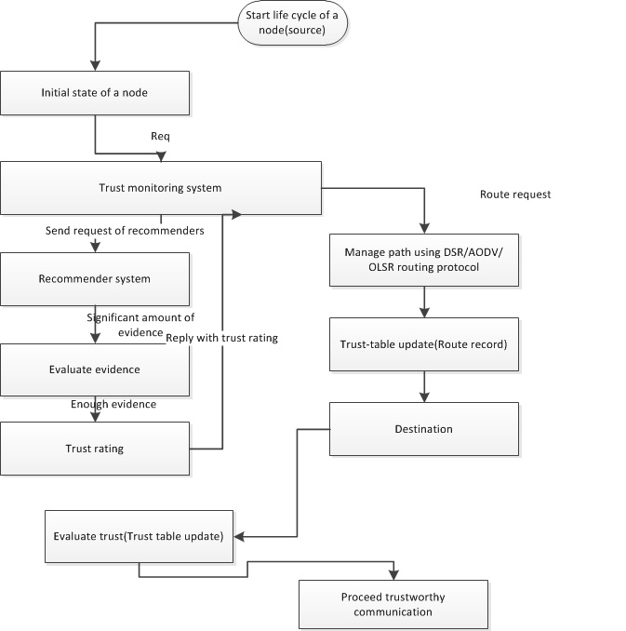
Introduction to Trust

Slide 5
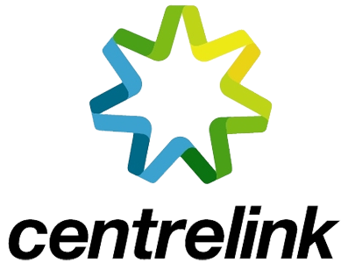
An Australian Case
Notes:
Besides cryptocurrency, blockchain can also be used as a registry based system and can record, monitor, track, and transact an array of assets.

Slide 6
Proposed Solution
‘Trusted’ Ledger Database
Will reduce settlement counterparty risk
Can almost instantly share matched trade information in the post-trade process
Notes:
The reason behind this is that blockchain technology adds transparency by having a distributed ledger in place, therefore, it’s really hard for business to hide any dubious activities.
Trust and transparency are made in an instant, and this innovative form of technology has only just scratched the surface.
The Proposed Model:
● Data held immutable by the blockchain.
● trust grows over time.
● Canonical source of data.
● Identity remains the Ownership of the individual.

Slide 7
An Australian Case Study
Here the chain, represents trust-based ledger node which includes the requirement for a consensus transaction approval

Slide 8
Proposed Solution
Notes:
Here the financial services will act as a root of trust based in a globally shared ledger. Each asset within the financial service will comprise with its own Internet blockchain address and corresponding private key. Each trusted node will have an application for a user interface and login and web browser to issue, trade, transfer and redeem commercial paper (by digitally represent a record of ownership ) – this approach significantly reduced settlement time and eliminated the need for paper stock certificates

Slide 9
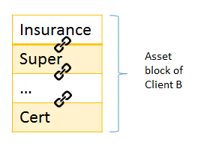
Proposed Model
Financial Service (root) Blockchain Address
Insurance
Super
…
Cert
Asset block of Client A
Client A
Client B
Client C
Insurance
Super
…
Cert
Updated-Insurance
Super
…
Cert
Client D
Insurance
Super
…
Cert
Block 1
Block 2
Notes:
enterprise applications of blockchain

Slide 10
Proposed Solution
Trust-based blockchain API system concept - to reduce the settlement latency amongst various assets.
The bundled assets must trust each other and be identified. This enables instant settlement with close to zero-cost amongst various assets, hence enhancing scalability.
The built-in security system of blockchain will retain the data privacy amongst trusted nodes of the assets.
Notes:
By removing intermediaries and providing a trusted and shared view of permissioned data, blockchain could:
• Reduce costs (e.g. fewer reconciliation errors)
• Speed up settlement (e.g. faster validation)
• Increase resilience (e.g. no single point of failure)
• Improve transparency (e.g. easier to monitor)
“distributed ledger technology could reduce banks’ infrastructure costs […] by between $1520 billion per annum by 2022”
The goal of the trusted blockchain API is to preserve the consistency amongst various assets

Slide 11
Conclusion
How to move forward with non- cryptocurrency distributed ledger start-ups focused on building tools and applications for financial institutions

Slide 12
Thank you
Any questions?

Slide 13
