Slide 1
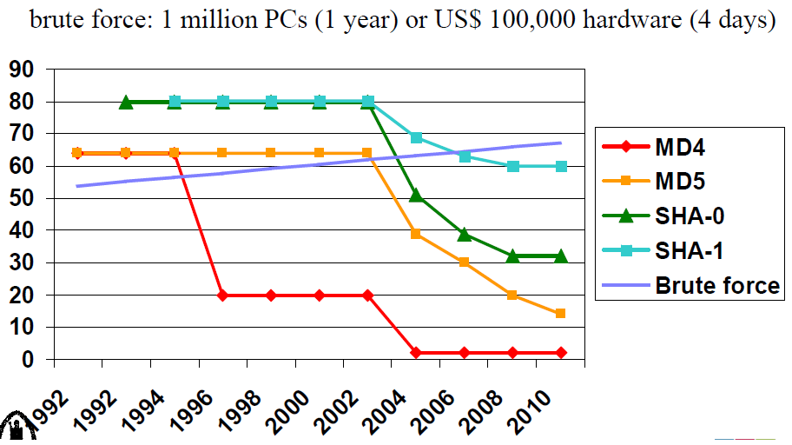
Design Patterns which Facilitate Message Digest Collision Attacks on Blockchains
Symposium on Distributed Ledger Technology SDLT'2017
Gold Coast Campus, Griffith University
June 13, 2017
Peter Robinson, peter.robinson@sent.com School of Information Technology and Electrical Engineering, University of Queensland.

Slide 2
Overview
Message digest algorithms are one of the underlying building blocks of blockchain platforms such as Ethereum.
This paper analyses situations in which the message digest collision resistance property can be exploited by attackers.
Two mitigations for possible attacks are described:
Longer message digest sizes make attacks more difficult; and,
Including timeliness properties limits the amount of time an attacker has to determine a hash collision.
Ref 1: Image on cover slide: Preneel, B. (2013) “Introduction to the Design and Cryptanalysis of Cryptographic Hash Functions” Available: https://www.cosic.esat.kuleuven.be/summer_school_albena/slides/preneel_hash_july2013_shortv1_print.pdf

Slide 3
Message Digest / Cryptographic Hash Algorithms
Digest Algorithm (Hash):
Variable length input => Fixed Length Output.
Address Hash:
Bitcoin and Ripple: RIPEMD160(SHA256): 160 bit digest,
Ethereum: KECCAK/160: 160 bit digest.
Main Hash:
Bitcoin: SHA256(SHA256): 256 bit digest,
Ethereum: KECCAK/256: 256 bit digest,
Ripple: 256 bit truncated SHA512: 256 bit digest.

Slide 4
Message Digest Security Strength & Cryptanalysis
Preimage
Resistance
Second Preimage
Resistance
Collision
Resistance
?
x
≠
?
?
≠
?
Hash
Hash
Hash
Hash
Hash
h(x)
h(x)
=
h(x’)
h(x)
=
h(x’)
Classical Quantum
n n/2
n n/2
n/2 n/3

Slide 5
NIST Recommendation on Security Strength
80 bit Security Strength algorithms should not be used after 2010².
160 bit message digest functions provide 80 bits of security strength for collision resistance property.
Address hashes used by Bitcoin, Ethereum, and Ripple may be susceptible to collision attacks by large state based actors.
Ref 2: NIST (2009) “DISCUSSION PAPER: The Transitioning of Cryptographic Algorithms and Key Sizes” http://csrc.nist.gov/groups/ST/key_mgmt/documents/Transitioning_CryptoAlgos_070209.pdf
SP800-57: http://csrc.nist.gov/publications/nistpubs/800-57/sp800-57-Part1-revised2_Mar08-2007.pdf
EINSA: https://www.enisa.europa.eu/publications/algorithms-key-sizes-and.../fullReport

Slide 6
Design Patterns to Avoid / Exploitation Scenarios
The attacker chooses the value to be digested.
The attacker is able to trick an entity into doing something based the message digest and value.
There is no time-sensitive aspect to the value.
Time-sensitivity is important as the first message digest collisions for an algorithm have historically taken a significant period of time.

Slide 7
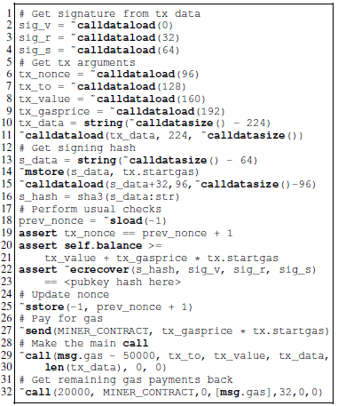
Attack Scenario #1: EIP86 Transaction Verification Contracts
Contract is deployed the address calculated as: Keccak256(rlp:encode([creator+nonce+initcode]))%2¹⁶⁰
Where:
creator is the account that created the contract,
nonce is a value which should be sequential,
initcode is the initialization code for the contract.

Slide 8
Attack Scenario #1: EIP86 Transaction Verification Contracts
An attacker who had broken the message digest collision resistance property could manipulate the nonce value or the contents of the contract such that there exists two contracts which would be deployed to the same address.
The attacker could show one variant of the contract to a user and persuade them to send some Ether to the address. The attacker could then deploy the nefarious contract and spend the Ether.

Slide 9
Attack Scenario #2: Proposal for Proof of Stake Agreed Random Number
Ethereum’s Proof of Stake proposal needs an agreed random number to use to choose which miner will create the next block.
One proposal is:
Each miner generates a random value,
To prevent cheating, miners submit commitment values: message digest(random value),
The random values are then exposed and combined using XOR to produce the agreed random number.

Slide 10
Attack Scenario #2: Proposal for Proof of Stake Agreed Random Number
An attacker who had broken the collision resistance property could:
Determine two random values which hash to produce the same commitment value,
Submit their commitment value,
Then, after seeing the random values exposed by the other miners, choose which of their random values to deliver, thus influencing the resulting agreed random number.

Slide 11
Design Pattern & Attack Mitigations
The message digest size used for account numbers should be increased.
In an email from V. Buterin and M. Swende from the Ethereum team on May 18, 2017, they tentatively agreed to adopt this recommendation of mine.
A temporal component should be incorporated into designs.
The random value proposed for use in PoS should incorporate some value from a recent block.

Slide 12
Questions

