Slide 1
Disintermediated and Peer-to-Peer Organizations: A New Horizon? A Sociolegal Approach to the DAO
John Flood
Professor of Law and Society
Griffith University

Slide 2
TRUST
in a post-truth age?
Notes:
This is the central problem but how did we arrive at this? According to Karl Polanyi the introduction of the market changed relationships based on community trust into arms-length short term relationships devoid of trust. Markets automatically create the movements that criticize them in order to protect society and environment thereby giving them legitimacy. Counter-movement allows markets to survive—see government manoeuvres in recessions. Markets need propaganda to survive. So blockchain has potential to pierce this.

Slide 3
Notes:
Simplest kind of trust—dyad. No coalitions against others.

Slide 4
Notes:
Triads create dissonance and can be unstable—coalitions + exclusion. Two against one.

Slide 5
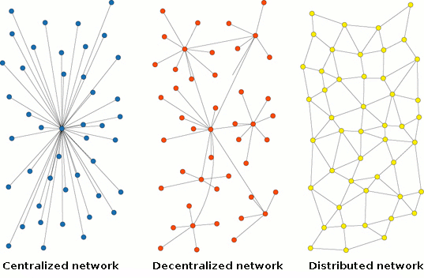
Notes:
The advantage of distributed networks is their inbuilt redundancy so that knocking out individual nodes doesn’t harm the network as compared to a centralised network.

Slide 6
Why distributed?
Estonia secures its banking infrastructure with blockchain—also e-residency
It has created an e-registry with Bitnation (Decentralized Borderless Voluntary Nation) to place notarized documents on a blockchain
Georgia is partnering with Bitfury, an asset transfer company, to design a land titling project
Notes:
Estonia has invested heavily in e-government.

Slide 7
Notes:
Mark Granovetter: strength of weak ties. Article available for download here: https://sociology.stanford.edu/sites/default/files/publications/the_strength_of_weak_ties_and_exch_w-gans.pdf

Slide 8
Notes:
Strong ties don’t necessarily help growth of networks whereas weak ties are more open.

Slide 9
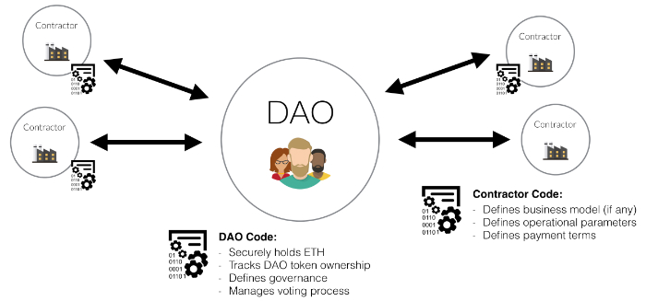
Notes:
Example of a DAO

Slide 10
Notes:
What the DAO is

Slide 11
Notes:
How the DAO works

Slide 12
Examples of DAOs 1
TheDAO by Slock.it: “universal sharing network where you can share whatever things you have…cars, houses”
In its manifesto TheDAO states its goal is to “blaze a new path in business organization for the betterment of its members, existing simultaneously nowhere and everywhere operating solely with the steadfast iron will of immutable code”
Notes:
Examples

Slide 13
Examples of DAOs 2
Notes:
The 3 websites show this proposal works:
See here hhttps://youtu.be/OAPqO3d3oGU
See https://youtu.be/ny9ivgstgag
See also https://www.reddit.com/r/ethereum/comments/4himxo/why_is_mobotiq_one_of_the_daos_first_proposals/

Slide 14
Examples of DAOs 2
Notes:
See above slide for links

Slide 15
What does the DAO signify?
Look at the archeology of the DAO
The Levellers held to "the doctrine of consent by participation in the choice of representatives.
They were committed broadly to the abolition of corruption within the parliamentary and judicial process, toleration of religious differences, the translation of law into the common tongue and, arguably, something that could be considered democracy in its modern form—arguably the first time contemporary democratic ideas had been formally framed and adopted by a political movement.
Notes:
What are the antecedents of the DAO? What is the thinking and philosophy that led to these initiatives emerging?

Slide 16
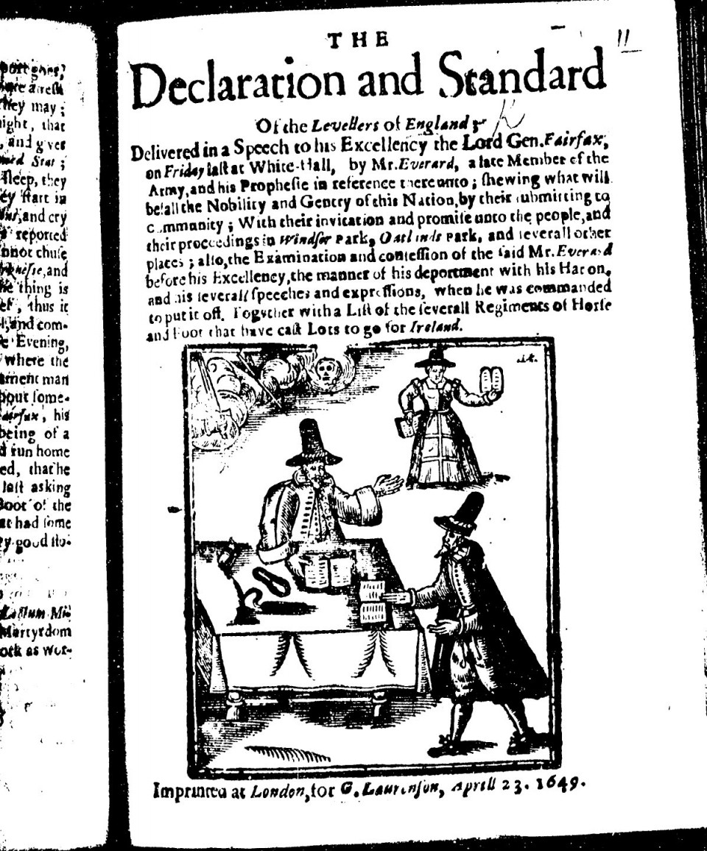
Notes:
Publication of the Levellers

Slide 17
What does the DAO signify?
Diggers were 17th century social anarchists who influenced many groups including the San Francisco Diggers of the 1960s who organized happenings. Some of their happenings included the Death of Money Parade…and Death of Hippie/Birth of Free. They were "community anarchists" who blended a desire for freedom with a consciousness of the community in which they lived
Notes:
Modern versions—the San Francisco Diggers who believed in self-sustaining economies.

Slide 18
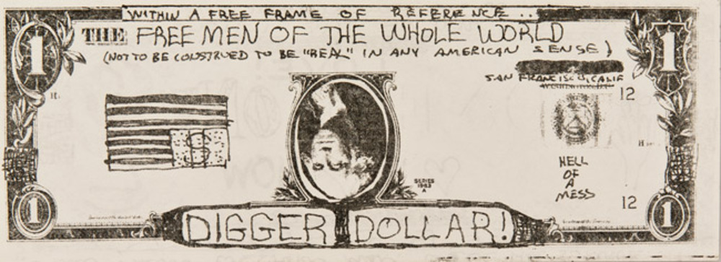
Notes:
Example of Digger Dollar.

Slide 19
What does the DAO signify?
Hayek, The Road to Serfdom and the rise of the pricing mechanism
Influential on modern economics and economists like Friedman
Notes:
Intellectual heritage through figures such as Hayek

Slide 20
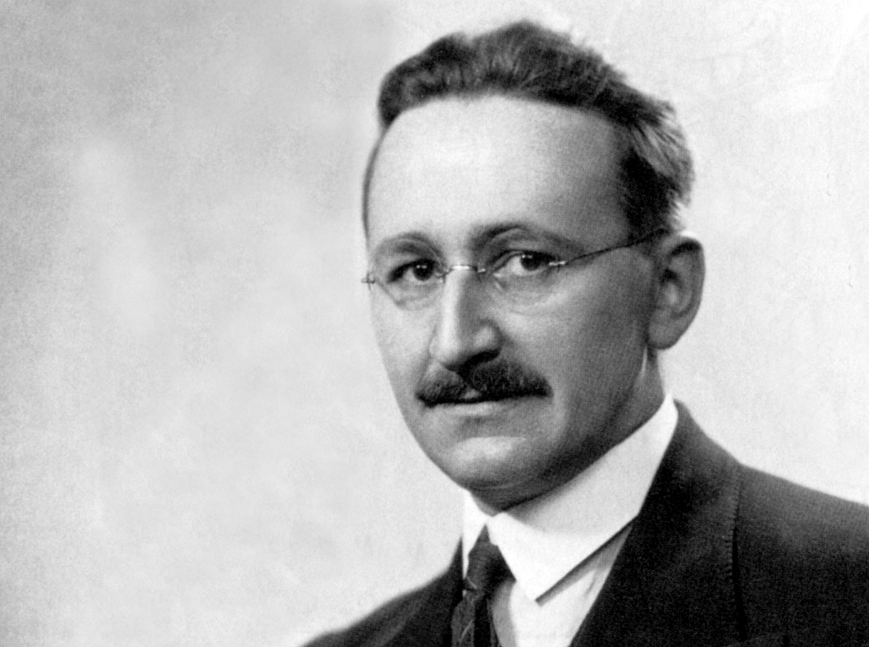
Notes:
Freidrich von Hayek

Slide 21
What does the DAO signify?
Milton Friedman and the Chicago Boys
Monetarism
Greatly influenced by Hayek
Both on faculty at University of Chicago
Notes:
Philosophy of anti-Keynesianism, anti-fiscal policy, continued by Milton Friedman.

Slide 22
Notes:
Milton Friedman

Slide 23
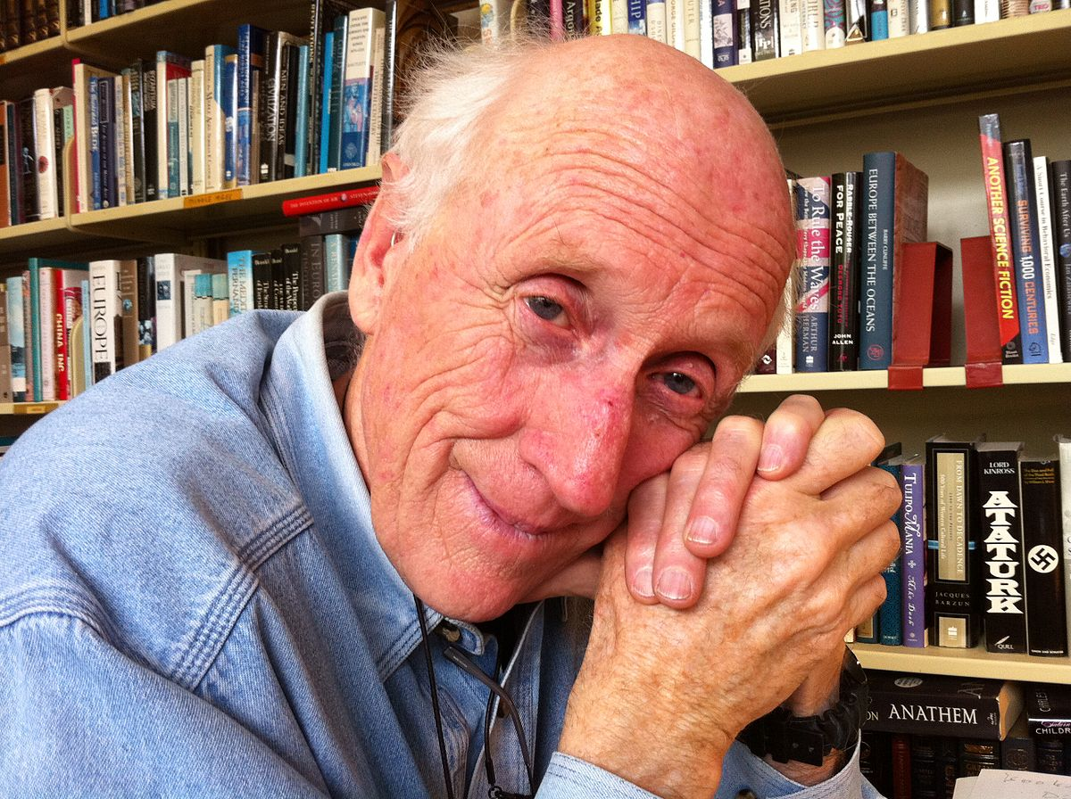
What does the DAO signify?
Has philosophical lineage to Stewart Brand of the Whole Earth Catalog: “Information wants to be free”
Notes:
The intersection between the Hippies and technology in figures such as Stewart Brand and the Whole Earth and Whole Software Catalogs.

Slide 24
What does the DAO signify?
"We are as gods. At a time when the New Left was calling for grass-roots political power, Whole Earth eschewed politics and pushed grassroots direct power—tools and skills. At a time when New Age hippies were deploring the intellectual world of arid abstractions, Whole Earth pushed science, intellectual endeavor, and new technology as well as old. As a result, when the most empowering tool of the century came along—personal computers (resisted by the New Left and despised by the New Age)—Whole Earth was in the thick of the development from the beginning.”
Notes:
The Whole Earth movement.

Slide 25
What does the DAO signify?
The DAO, blockchain, smart contracts are culmination of these political, social, economic and technological movements
How far is politics able to recognize the consequences of these? Could politics be undermined? And add in IoT, then?
For example, Estonia—online government with blockchain—health records, voting, Bitnation (DBVN) to create halocracy
Notes:
Blockchain and the DAO are culminations of these disparate movements and philosophies.

Slide 26
What does the DAO signify?
How do governments align with these developments?
Will social communities reconfigure themselves? The rise of the precariat. What is the moral dimension of blockchain and the DAO?
Is libertarianism inevitable? (Ayn Rand? Silk Road?) Is it a consequence of disintermediation?
Will local economies create potential of autonomy? A post-capitalism future of global economic commonwealth?
How does law and regulation catch up and cope?
Notes:
Many questions for our futures are raised by blockchain and cognate technologies.

