Slide 1
Challenges in Designing a Blockchain Platform
Babu Pillai, Vallipuram Muthukkumarasamy, Kamanashis Biswas
babu.pillai@griffithuni.edu.au, {k.biswas, v.muthu} @griffith.edu.au
School of ICT, Griffith University, Gold Coast, Australia
Notes:
Good afternoon
My name is Babu Pillai
This presentation is about my research proposal on “Challenges in Designing a Blockchain Platform”.
NEXT SLIDE

Slide 2
Blockchain
Blockchain Platforms
Platform Design Challenges
Blockchain Components
Current Research
Research Proposal
http://www.emeraldinsight.com/loi/intr
Notes:
The structure of this presentation is as follows:-
What motivated me to look at blockchain technology
Background on blockchain (non technical)
Research question
My blockchain model
Research approach
Research objective and scope
Research time line
NEXT SLIDE

Slide 3
https://www.cbinsights.com/blog/industries-disrupted-blockchain/
http://www.huffingtonpost.com/ameer-rosic-/5-blockchain-applications_b_13279010.html
https://techbeacon.com/blockchain-it-right-your-app
https://medium.com/zeppelin-blog/the-ugly-truth-about-blockchain-applications-73e55cad9582

Slide 4
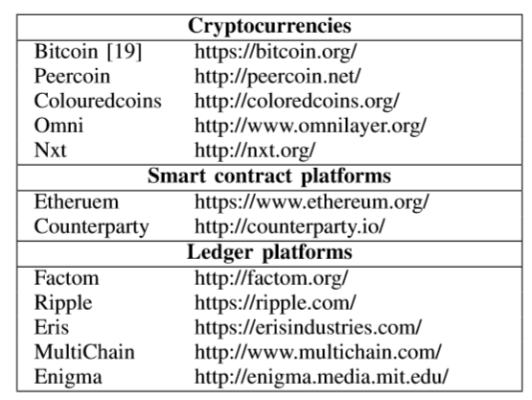
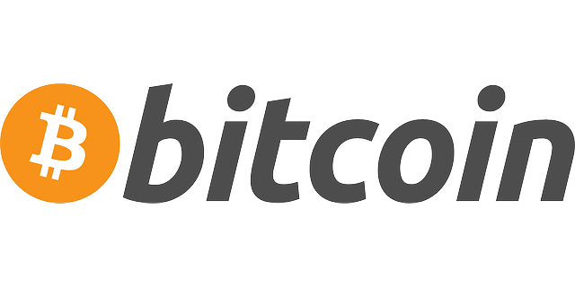
The Blockchain
 | The first virtual currency.
 | Smart Contracts
Blockchain 1.0
Blockchain 2.0
Notes:
there are number of platforms available – that vary in their design and functionality
Bitcoin - is designed for payment system-
Ethereum – a general purpose platform
Multichain – is a private blockchain platform - create your own private blockchains with different permissions (create, send, mine…) .
Corda R3 is an opensource blockchain platform – made for banks
NEXT SLIDE

Slide 5
Blockchain Platforms
Public, opensource, support smart contract
Design best for finance industry
A permissioned blockchain
Opensource, under Linux Foundation, driven by a governed board.

Slide 6
Issue in Designing a Blockchain Platform
It is challenging as this technology is;
Not Matured
Not Systematically Explored (Xu et al., 2016)

Slide 7
For Business a new technology should be
Interoperable
Secured
Easy to use

Slide 8
Blockchain Applications
Financing
Logistics
IoT devices
Legal
Blockchain
Credential Certification
Asset Management
Health Care

Slide 9
Issues and limitations
Many platforms
Different types offerings
Monolithic design
Lack of testing
Opensource development
“which platform to choose from many that are available today” (Dinh et al., 2017)

Slide 10
Current research
Mainly focused on the various technical areas;
Security, performance, data integrity, privacy and scalability
(Yli-Huumo, Ko, Choi, Park, & Smolander, 2016).
The usability of these platforms is an issue (Lindman, Rossi, & Tuunainen).

Slide 11
Current Approaches
Understand the design goals
Study the platform structure and the underlying architecture (Natoli & Gramoli, 2016).

Slide 12
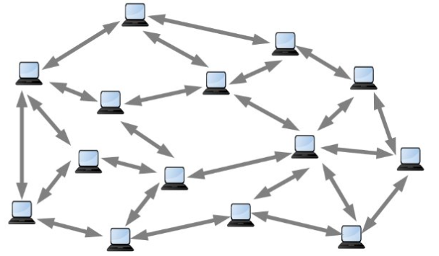
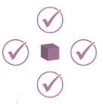
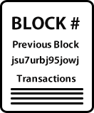
technology model
IoT devices
Applications
Business logics
API & Interfaces
Network
Ledger
Consensus
The Components
Validators
Public or Private
Incentives
Security
Privacy
Scalability
Speed
Block Size
PoW/PoS
Notes:
This is the technology model
The components
The network - peer-to-peer – that can be public or private - who can participate, view and make transaction -- do you need to know who they are ?
Then the ledger the -- shared database -- “Database with multiple writers” – which mean there are more than one entity's – who are the validators, the scalability, speed, block size…
Then the consensus mechanism – proof-of-work or proof-of-stake and many more other ones --do you need to know who they are ? Or given them a rule to follow?
-- what are the incentives for validators (miners)
Which form a model of platform –
in computing the platform is consider as a self contained container to develop things on top of it.
there are number of platforms developed now , some are designed for trading crypto currency, some are for asset transfer, some are able to contain a smart contract in it.
NEXT SLIDE

Slide 13
Current approaches
 | Public | Private | Hybrid
Permission | open | Permissioned | Permissioned
Speed | Slow | fast | fast
Consensus | Proof-of-work | proof-of-stake/ Pre-approved participations | Pre-approved participations
Identity | Not known | known | known
Trust | Trustless | trusted | trusted
decentralised | Fully | no | Partly
Notes:
NEXT SLIDE

Slide 14
Current approaches
The Consensus mechanisms
Proof-of-work
Proof of Stake
Usability and Scalability of the platform

Slide 15
Our Research
Identifies and describes,
the challenges that are considered when
designing a platform and to ensure security, reliability and usability.
We aim to investigate
Interoperability between different platforms
integration with existing systems (e.g. IoT)

Slide 16
References
Dinh, T. T. A., Wang, J., Chen, G., Liu, R., Ooi, B. C., & Tan, K.-L. (2017). BLOCKBENCH: A Framework for Analyzing Private Blockchains. doi: arXiv:1703.04057
Lindman, J., Rossi, M., & Tuunainen, V. (2017). Opportunities and risks of Blockchain Technologies in payments – a research agenda.
Natoli, C., & Gramoli, V. (2016, Oct. 31 2016-Nov. 2 2016). The Blockchain Anomaly. Paper presented at the 2016 IEEE 15th International Symposium on Network Computing and Applications (NCA).
Xu, X., Pautasso, C., Zhu, L., Gramoli, V., Ponomarev, A., Tran, A. B., & Chen, S. (2016). The Blockchain as a Software Connector.
Yli-Huumo, J., Ko, D., Choi, S., Park, S., & Smolander, K. (2016). Where Is Current Research on Blockchain Technology?—A Systematic Review. PLOS ONE, 11(10), e0163477. doi:10.1371/journal.pone.0163477

Slide 17
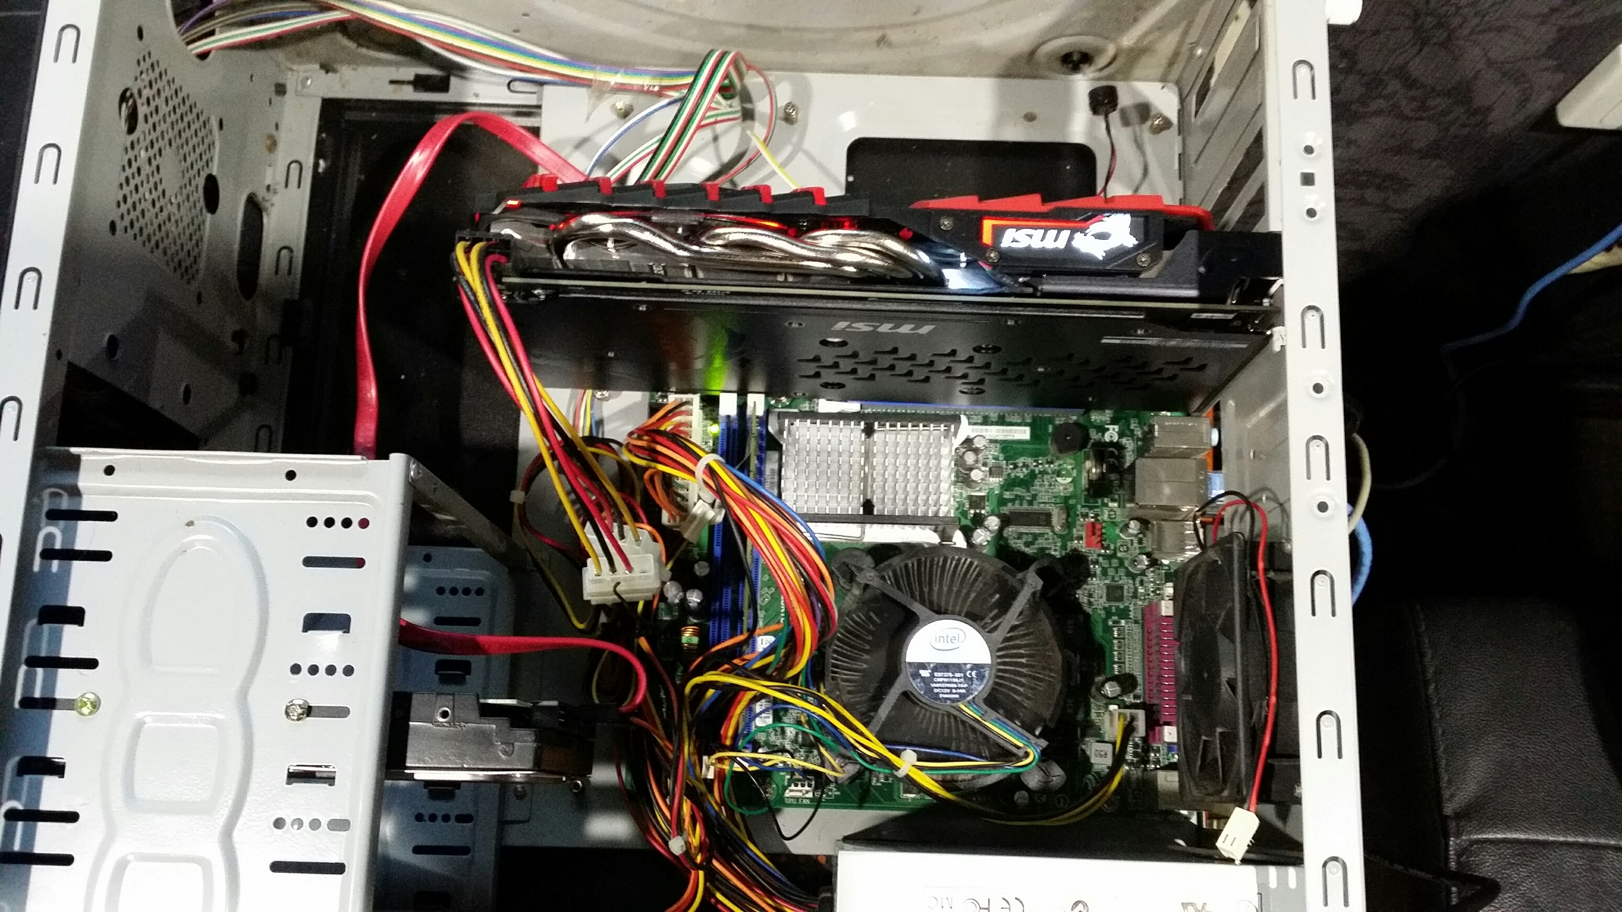
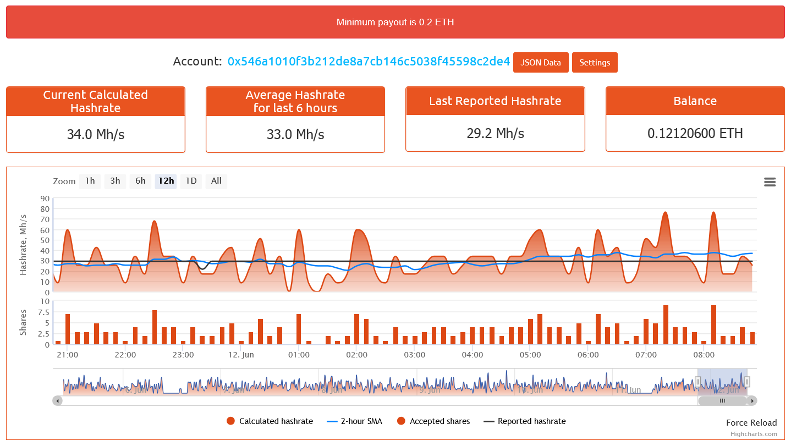
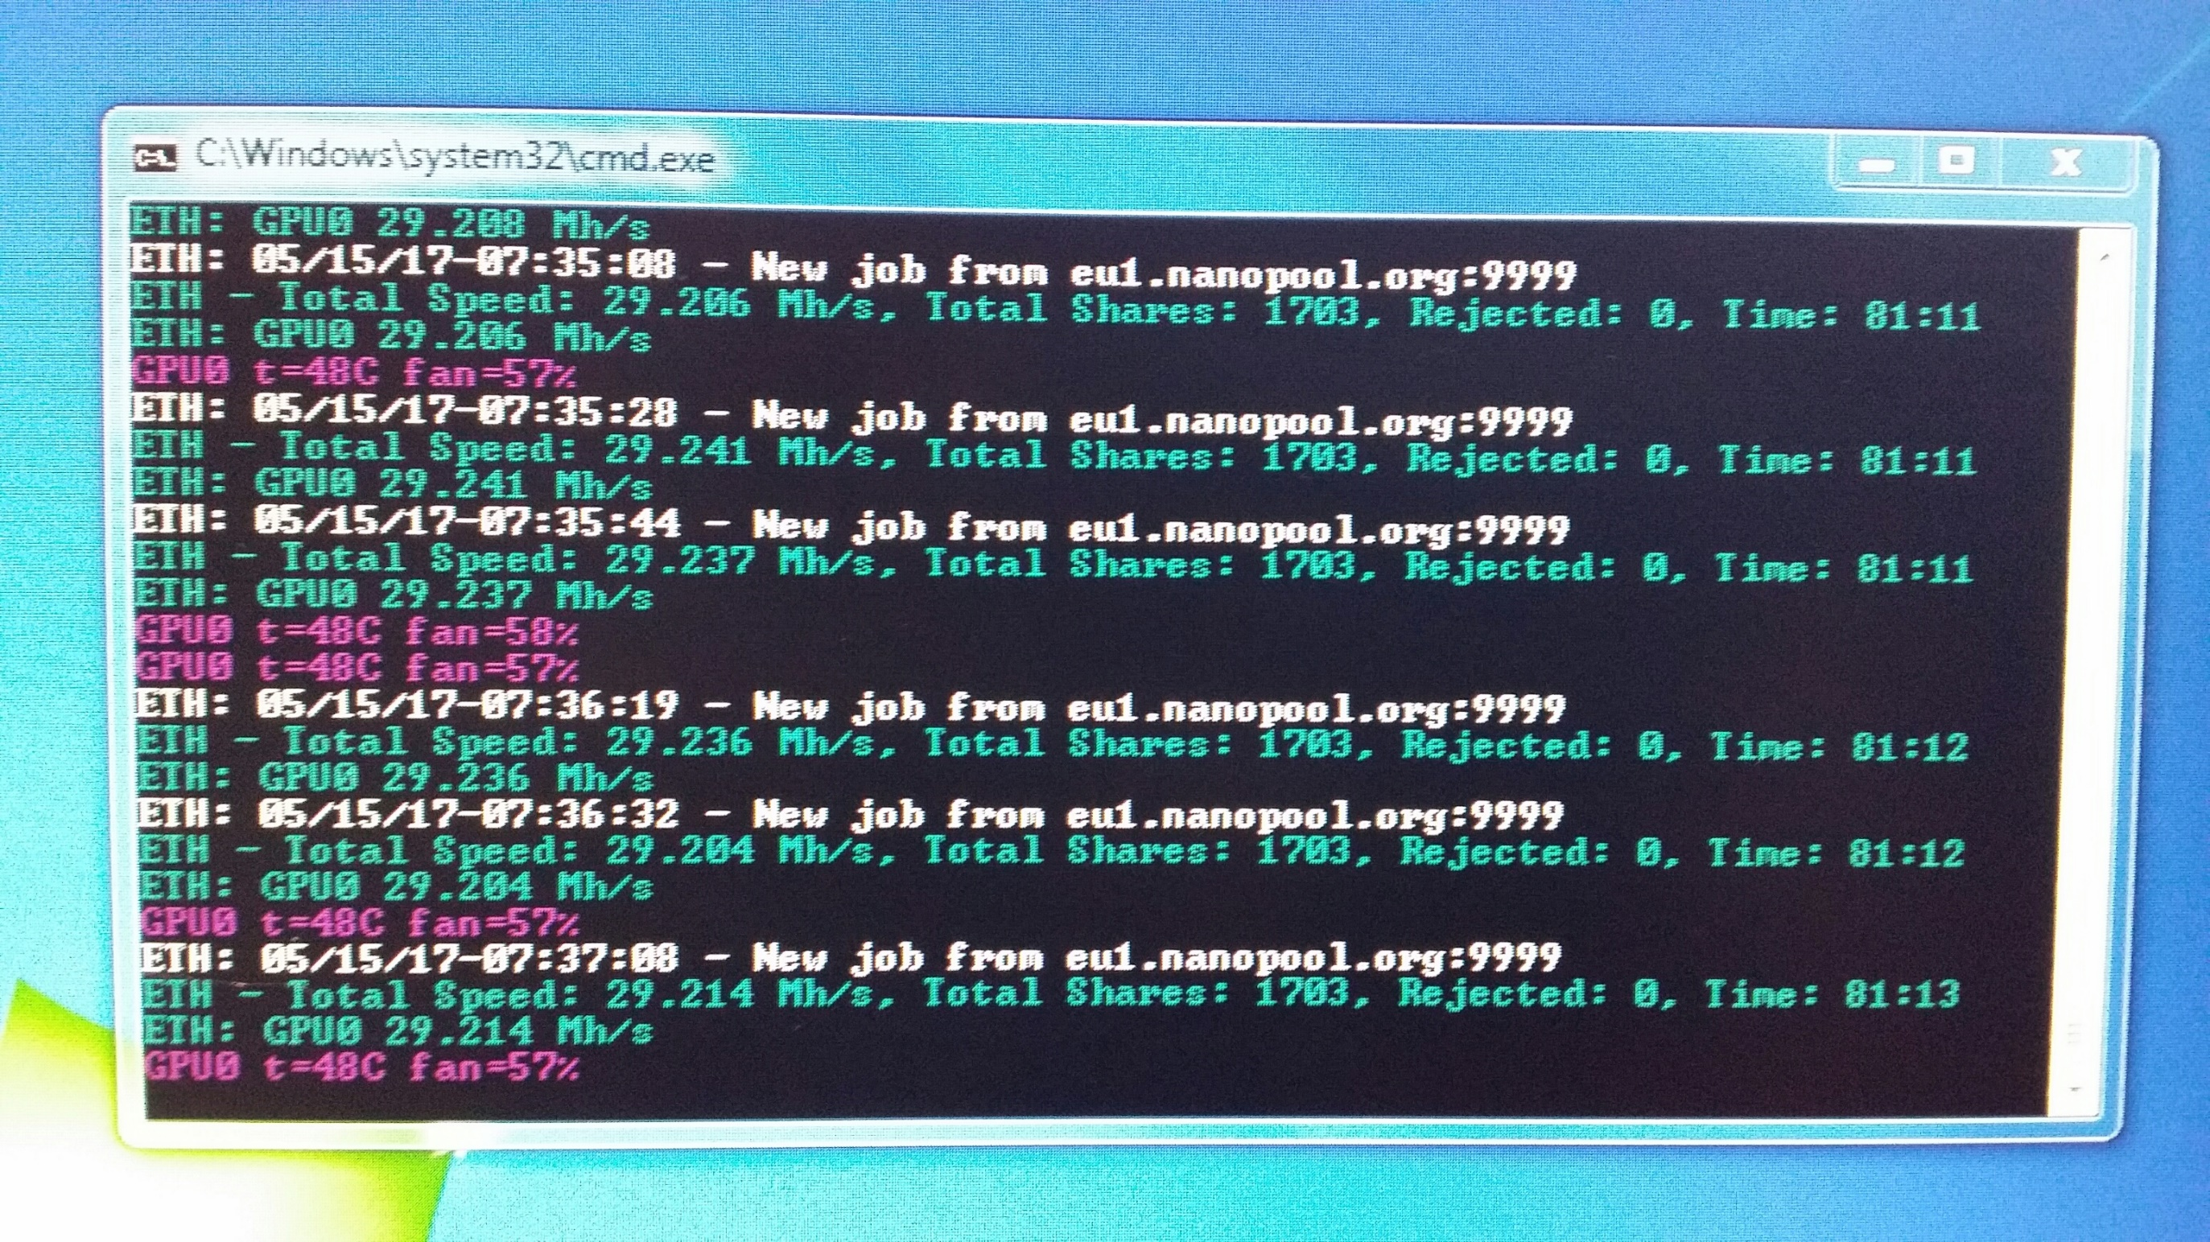
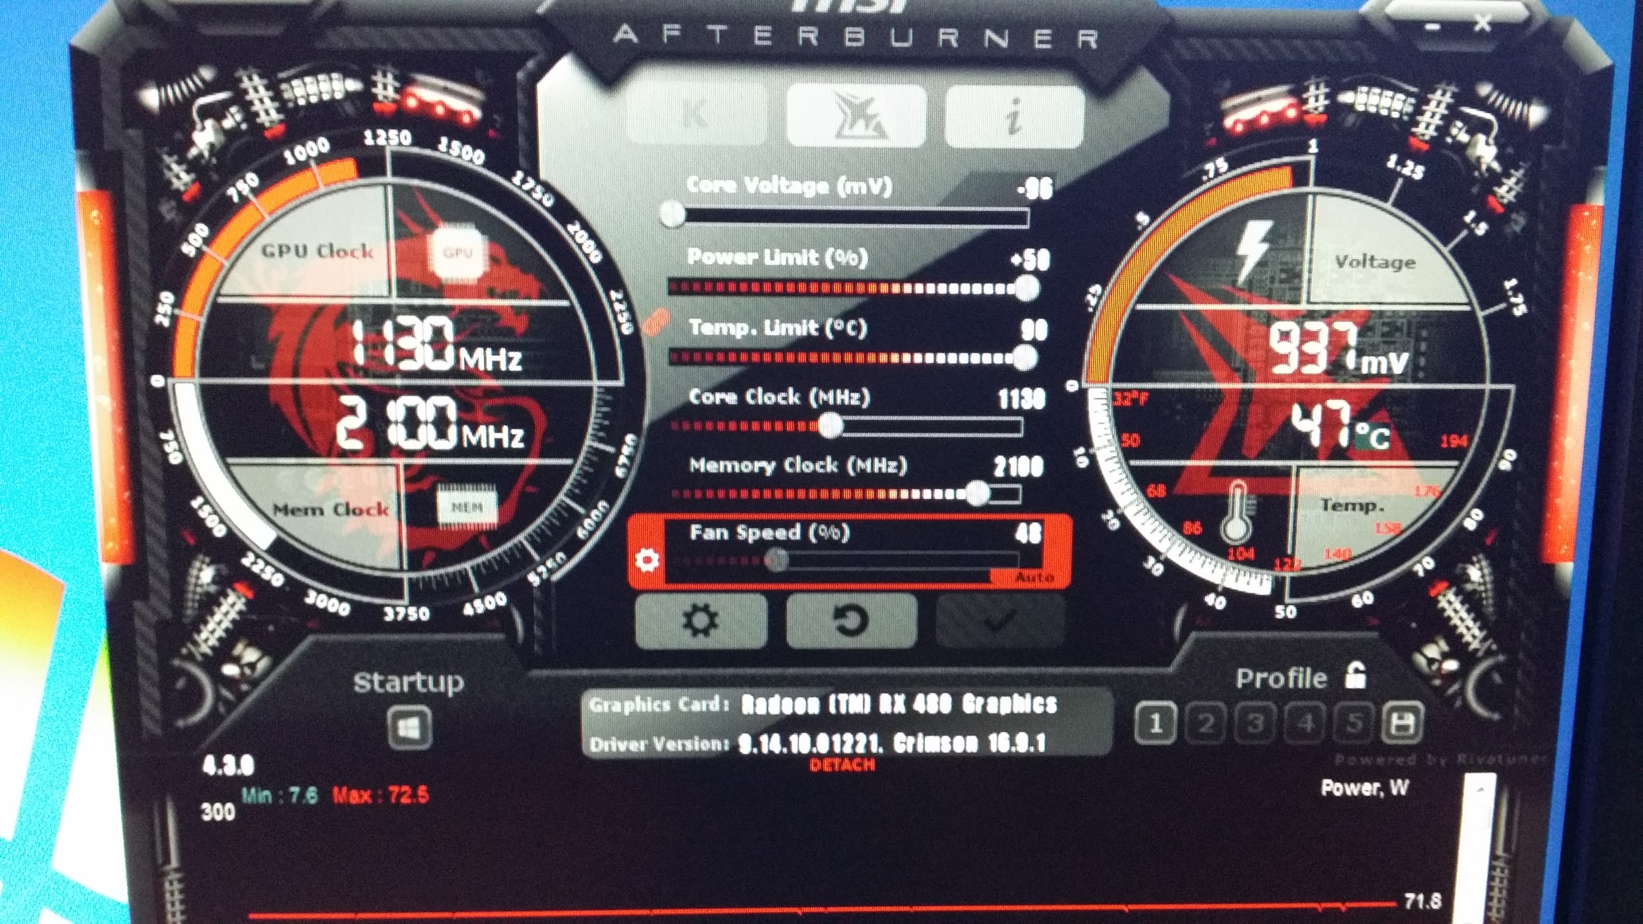

Slide 18
Thanks..
Thanks to Muthu and KB.

